Slide 1
Election DB
Omer nachshon
Maor Efrati

Slide 2
Description
The program manages election system in an imaginary country under a panademic.
The system allows it’s citizens to vote in a kalpi that is relevant to them.
For instance:
soldiers vote at a military kalpi and sick citizens vote in an isolated kalpi.
The system allows citizens to run for a party as contenders.
Overall:
The system allows the user to add citizens of 5 types (including contenders), 4 types of kalpies , parties , and run voting system.
At the end of the voting phase, the user can view the results per kalpi/party.

Slide 3
Requirements
continuity
continuity
The database allows us to have the data of our system in an organized way outside the workspace (coding environment).
Before we added the DB our system was reset every time we ran it.
After we created and integrated the DB with our existing program , the user can load the existing data from the DB .
Overall:
The DB added continuity to our system ,in addition it gathers all the created data in an organized external platfrom.
*We integrated with MS SQL DB Server

Slide 4


Users
The organizer/s of the election.

Slide 5
Entities 1
Kalpies: There are 4 types of kalpies:
Kalpi (regular)- for healthy citizens and contenders (not soldiers)
MilitaryKalpi- for healthy soldiers only
MilitaryCoronaKalpi- for sick soldiers only
CoronaKalpi- for sick citizens and contenders.
Primary key is ID.
Every citizen (of all types) has a foreign key that indicates what kalpi it belongs to.
Party –
Primary key is name.
Every contender has a foreign key that indicates what party it belongs to.

Slide 6
Entities 2
Citizens: there are 5 types of citizens in our system:
Citizen (regular) – citizen which is not (contender,soldier,sick)
Contender – citizen which runs for a kalpi and not (sick,soldier)
CoronaPatient – citizen which is sick and not (contender,soldier)
Soldier – citizen which is 18-21 years old and not (contender,sick)
SickSoldier – soldier which is sick.
All types of citizens has a primary key - ID
All types of citizens has a foreign key - *kalpiNum*
The foreign key indicates what kalpi they can vote at.
*Soldiers have a key that indicates whether they carry a weapon or not.
*Sick citizens (of all kinds) have a key that indicates how many days they have been sick.

Slide 7
Entities 3
Summary:
Every citizen must belong to exactly 1 kalpi. (*kalpiNum)
Every contender must belong to exactly 1 party. (*partyName)
There must be at least 4 kalpies (as mentioned 2 slides earlier) before the citizens are requested to vote.

Slide 8
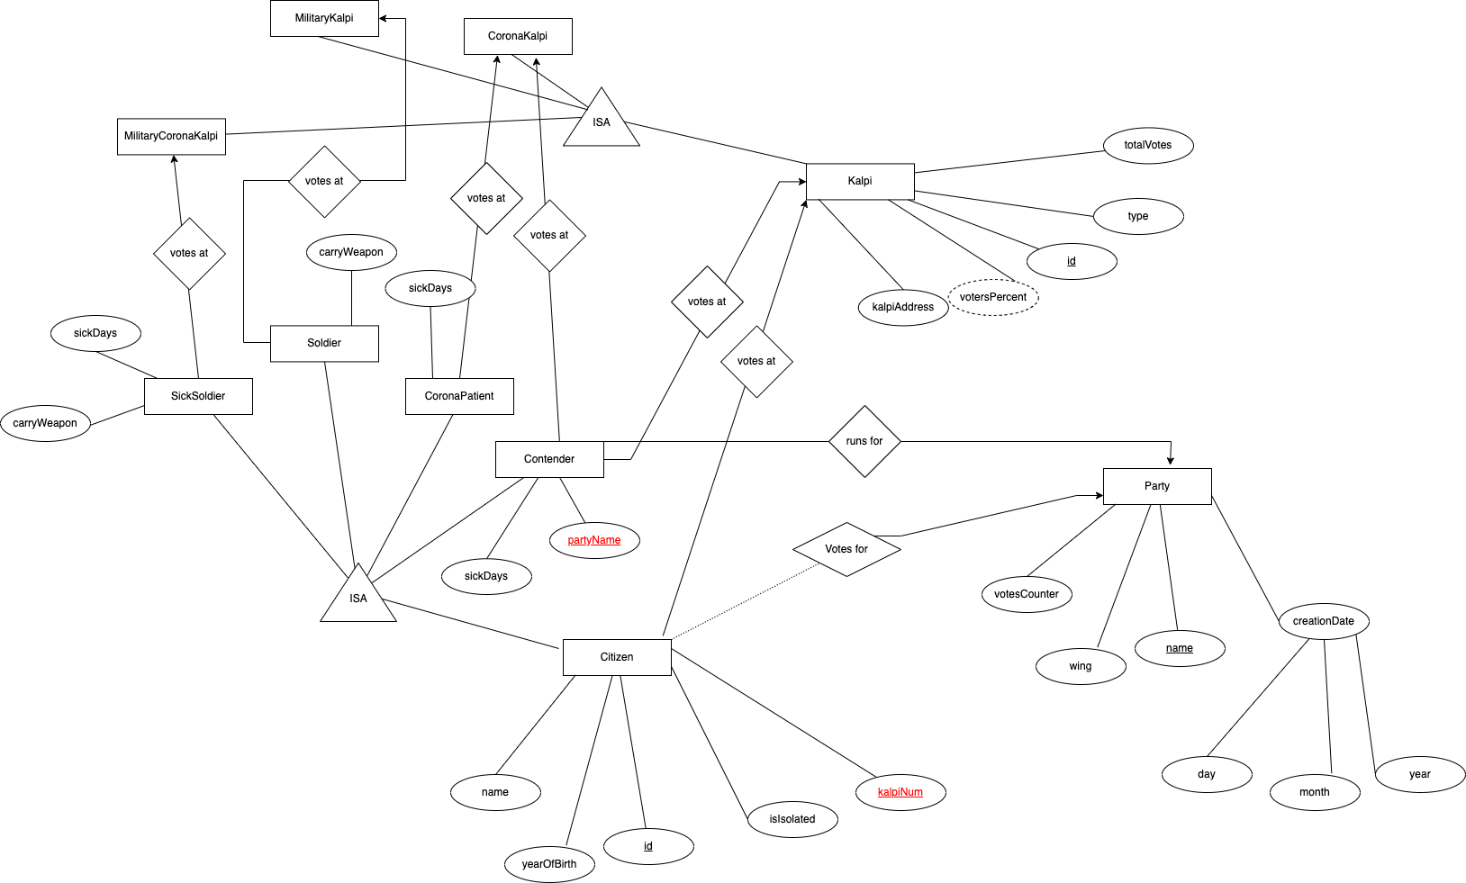
ERD

Slide 9
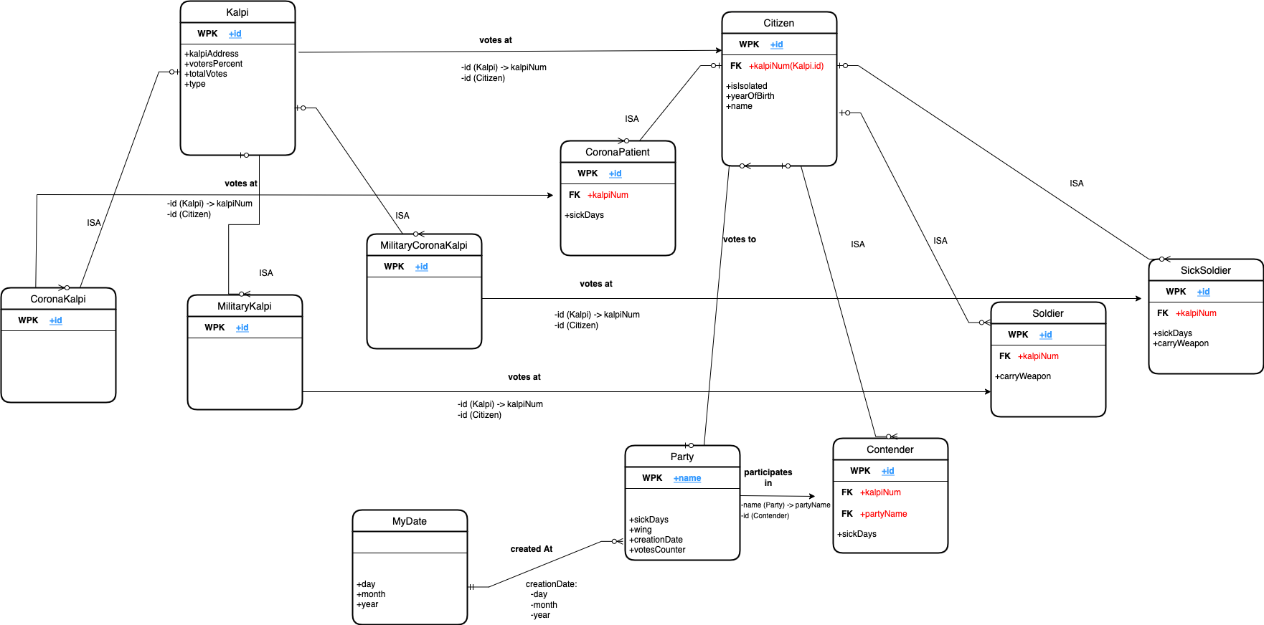
Tables

